Slide 1

PORTFOLIO MANAGEMENT PROJECT
GROUP 2
ANKIT RAWAT,

Slide 2
QUESTION 1
QUESTION 2
QUESTION 3

Slide 3
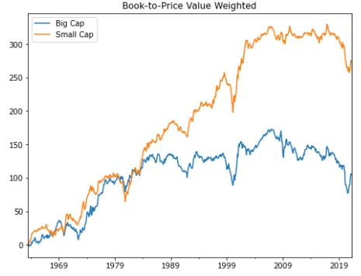
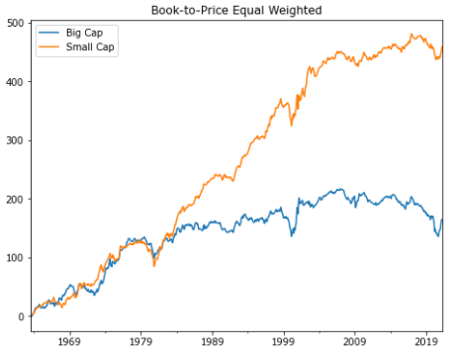
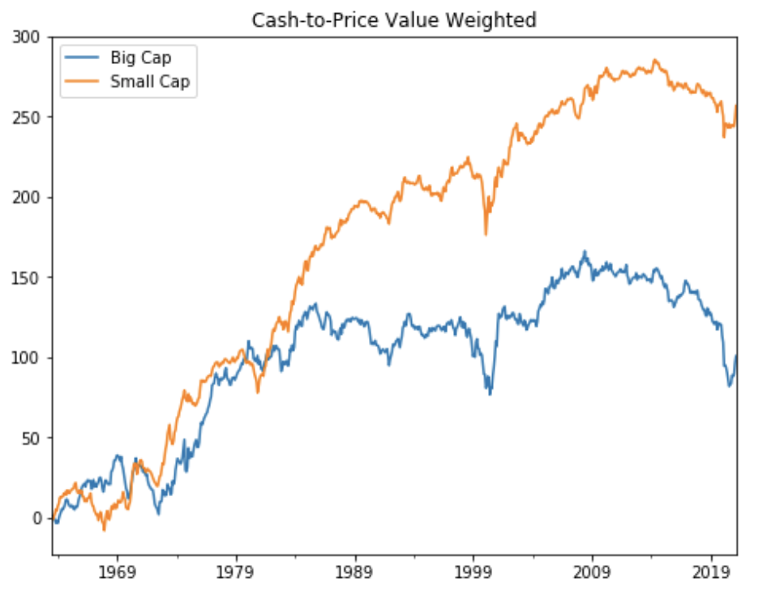
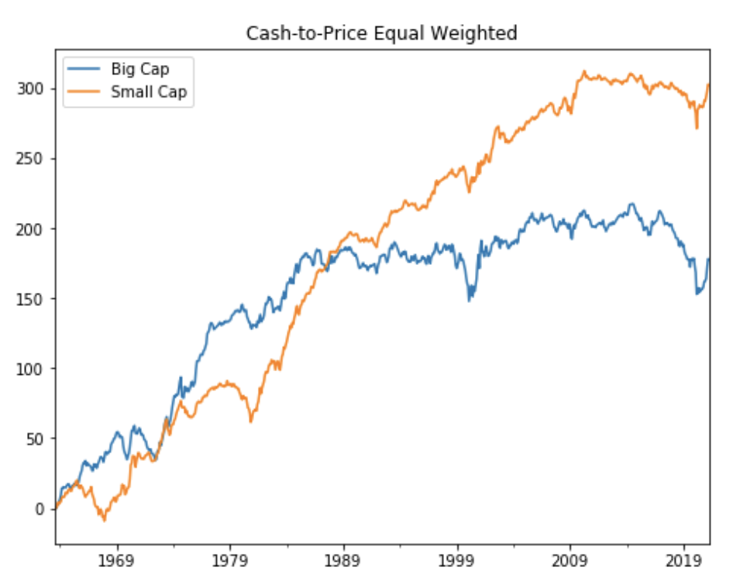
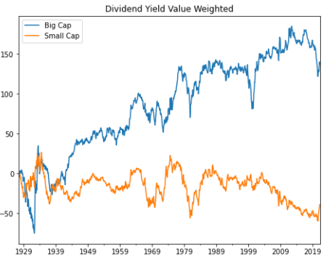
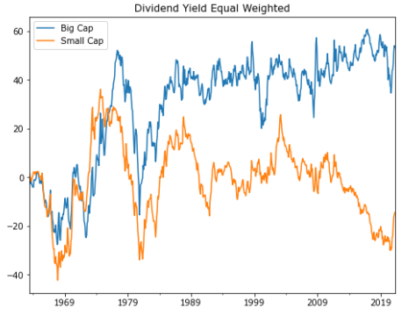
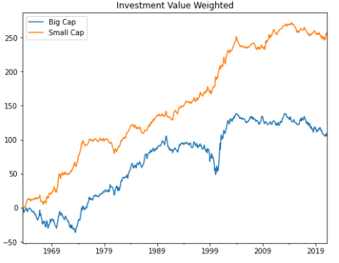
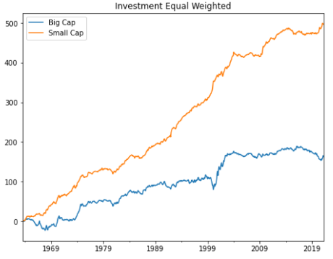
QUESTION 1
For each of the seven fundamental variables, construct long-short factor mimicking portfolios and plot their historical performance across different size segments.
FACTOR : Book-to-Price
FACTOR : Cash-to-Price
Value-Weighted
Equal-Weighted
Value-Weighted
Equal-Weighted
FACTOR : Dividend Yield
FACTOR : Investment
Value-Weighted
Equal-Weighted
Value-Weighted
Equal-Weighted
Notes:
For these seven fundamental variables, we can get the Book-to-Price ratio, Cash-to-Price ratio and 12-1 Momentum ratio are all presented that the small cap stocks are higher than the big cap stocks, both on value weighted and equal weighted method.
While, the Dividend Yield ratio, Investment ratio and Prior Month return are showed the opposite results. For the profitability ratio, the big cap is lower than the small cap stocks under value weighted method, but for equal weighted method, the big cap is higher than small

Slide 4
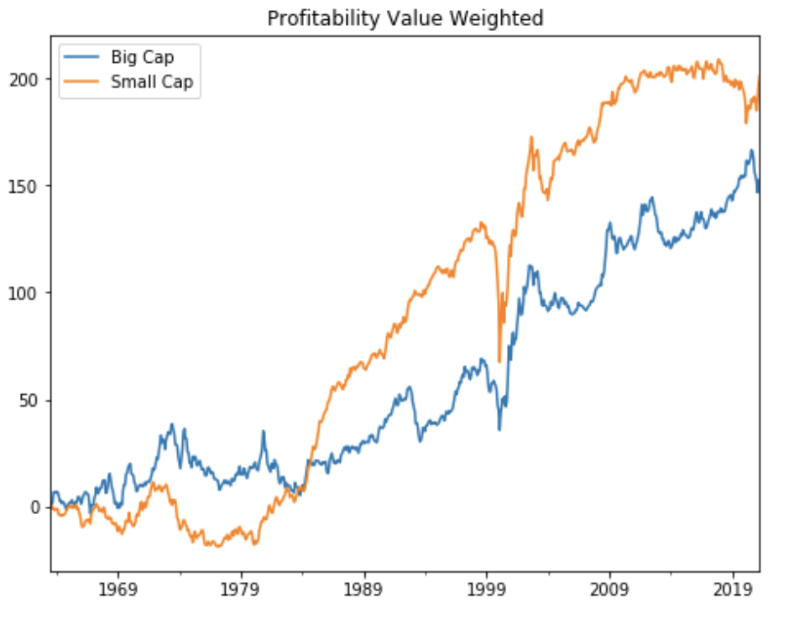
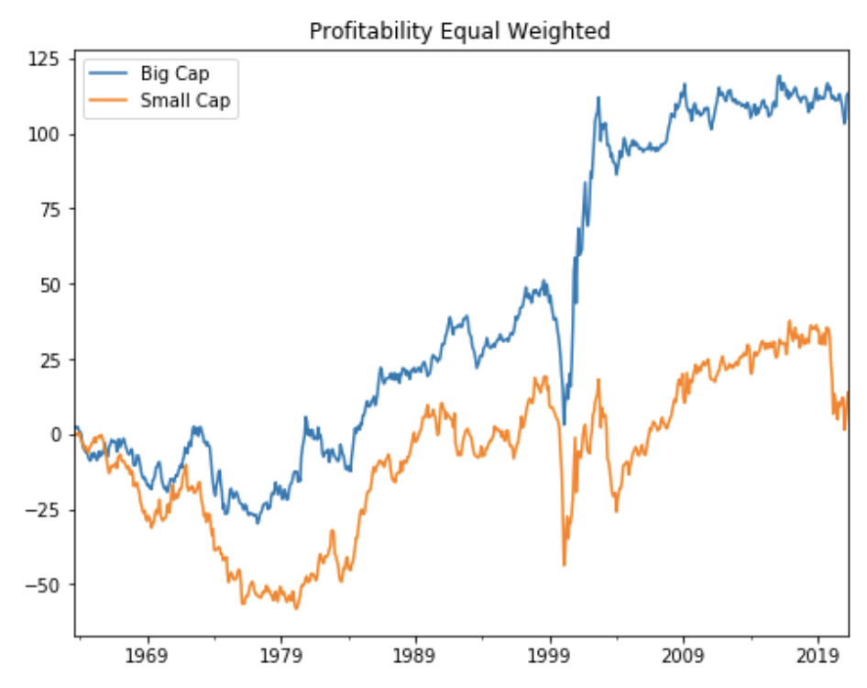
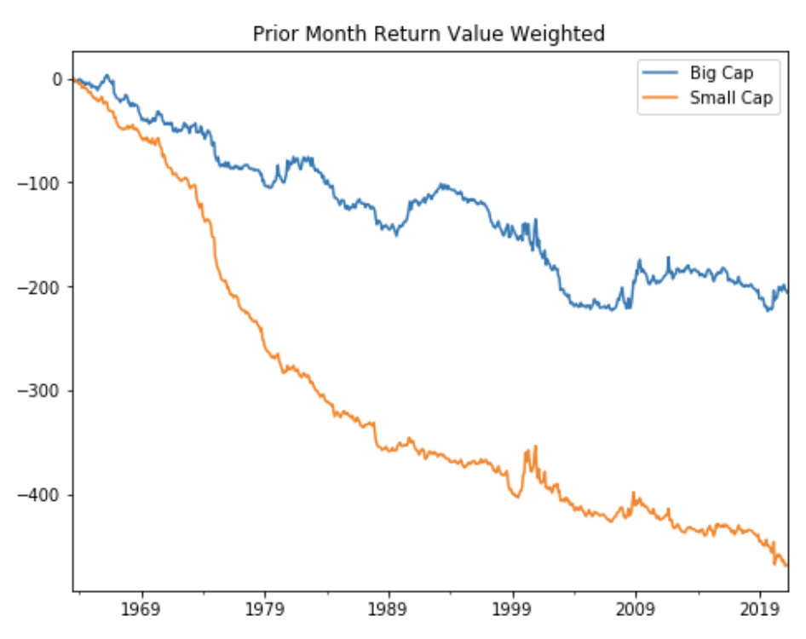
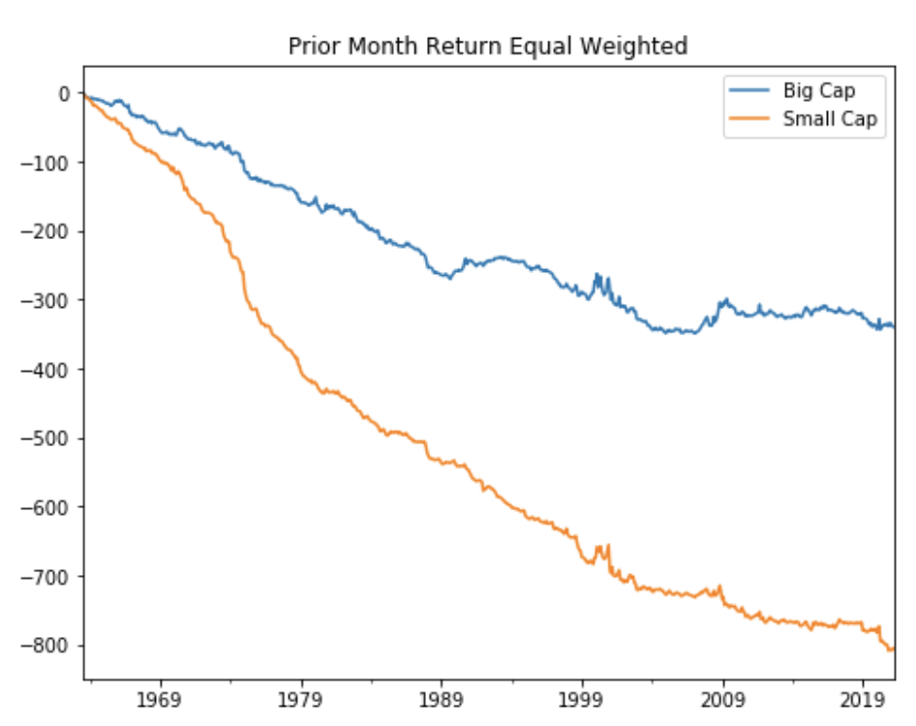
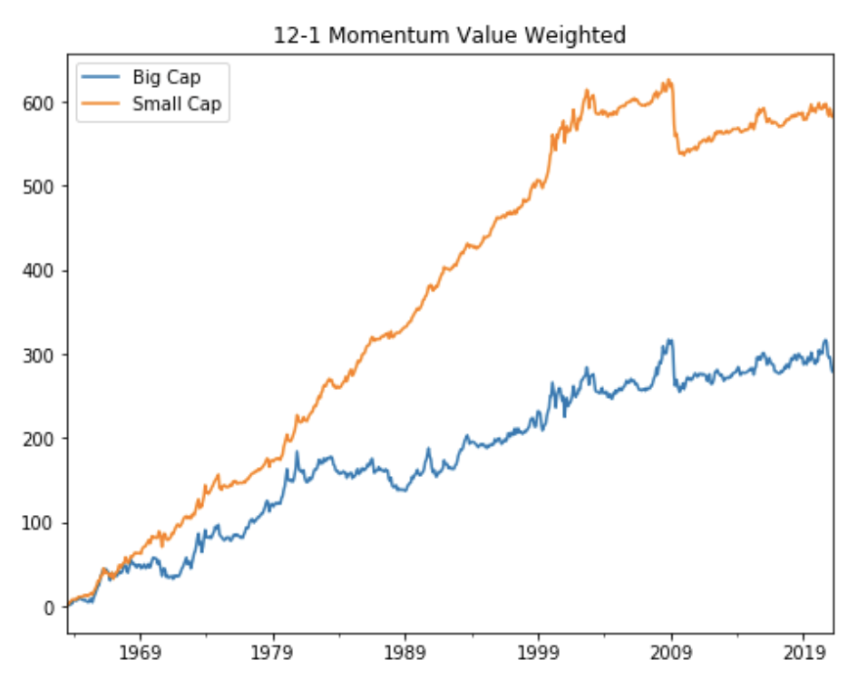
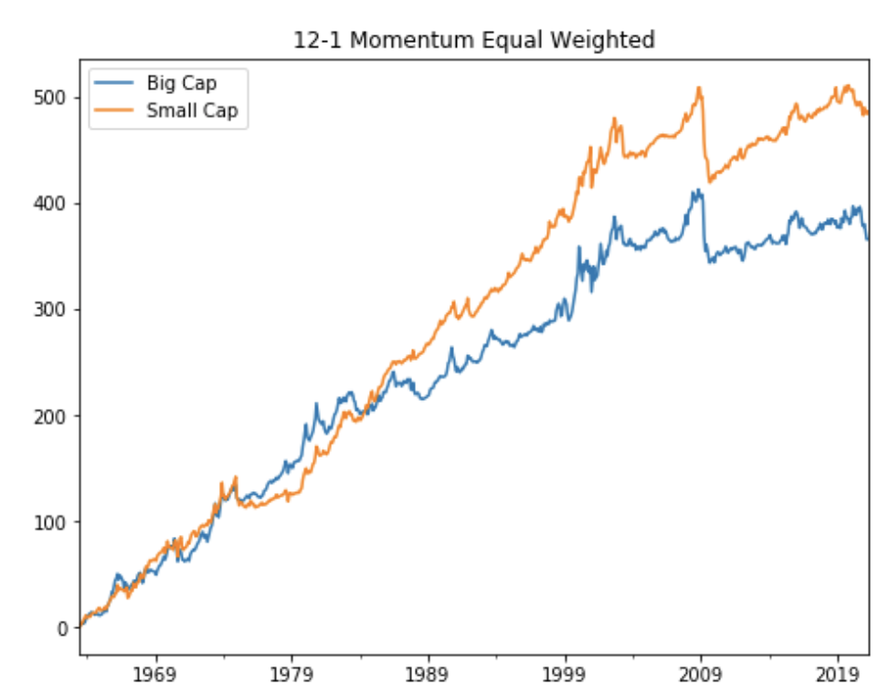
QUESTION 1
For each of the seven fundamental variables, construct long-short factor mimicking portfolios and plot their historical performance across different size segments.
FACTOR : Profitability
FACTOR : Prior Month Return
Value-Weighted
Equal-Weighted
Value-Weighted
Equal-Weighted
FACTOR : 12-1 Momentum
For these seven fundamental variables, we can get the Book-to-Price ratio, Cash-to-Price ratio and 12-1 Momentum ratio are all presented that the small cap stocks are higher than the big cap stocks, both on value weighted and equal weighted method.
While, the Dividend Yield ratio, Investment ratio and Prior Month return are showed the opposite results. For the profitability ratio, the big cap is lower than the small cap stocks under value weighted method, but for equal weighted method, the big cap is higher than small.
Value-Weighted
Equal-Weighted

Slide 5
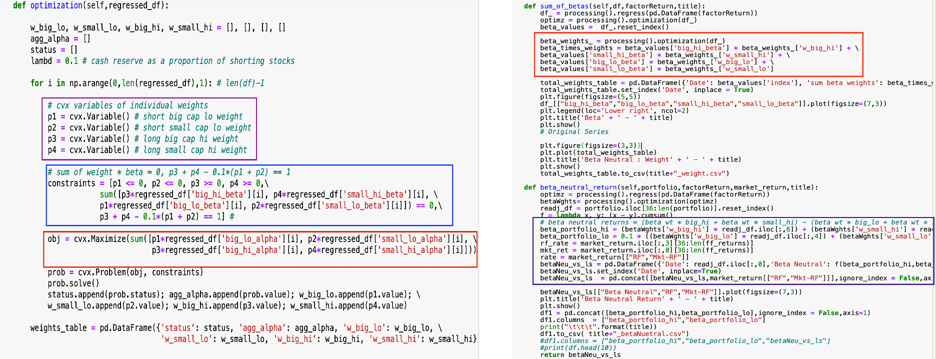
QUESTION 1
Taking the market return from Fama-French’s 3-factor model, calculate and plot the rolling 3-year market beta for these stylized portfolios
4
1
2
5
3
Optimization
Max(Σ [P3* β(big_hi), P4 * β(small_hi), P3* β(big_lo), P3*β(small_lo)])
Portfolio constraints
Constraints
p1 <= 0, p2 <= 0, p3 >= 0, p4 >= 0
Σ [P3* β(big_hi), P4 * β(small_hi), P3* β(big_lo), P3*β(small_lo)]) == 0
Σ(P1,P2,P3,P4) = 1
p1 = short big cap lo weight
p2 = short small cap lo weight
p3 = long big cap hi weight
p4 = long small cap hi weight
Beta Neutral Return
(β3_weight* big_hi + β4_weight * small_hi) - (β2_weight * big_lo + β1_weight * small_lo)

Slide 6
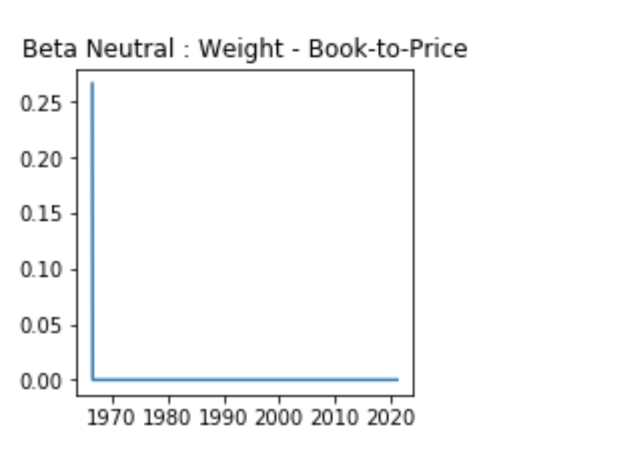
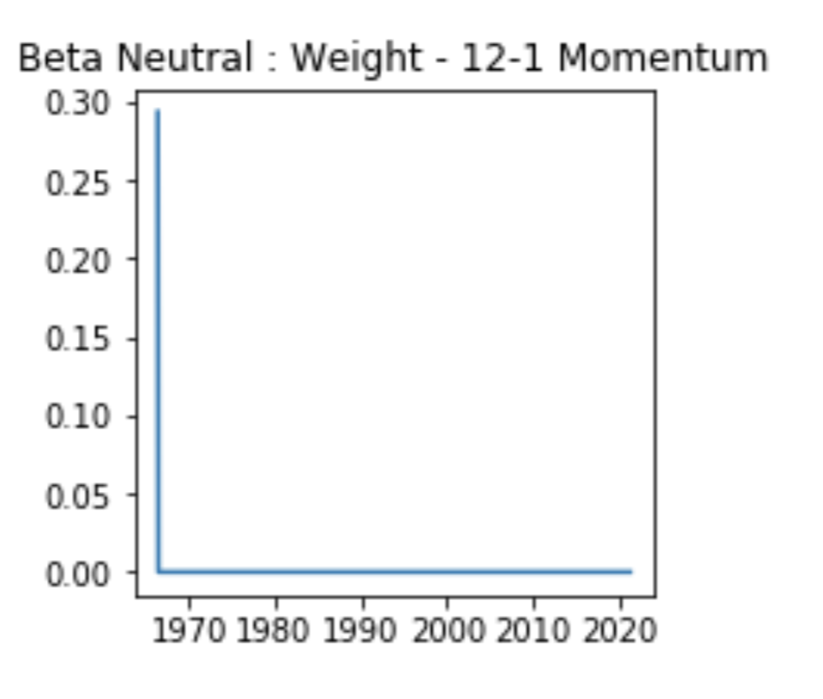
QUESTION 1
Taking the market return from Fama-French’s 3-factor model, calculate and plot the rolling 3-year market beta for these stylized portfolios
Beta-Neutral：Weight Book-to-Price
Beta-Neutral：Weight 12-1 Momentum

Slide 7
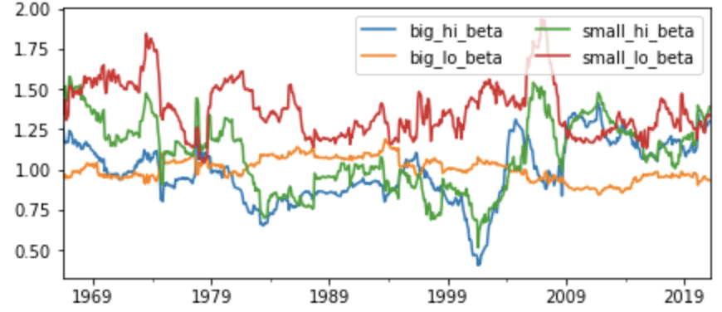
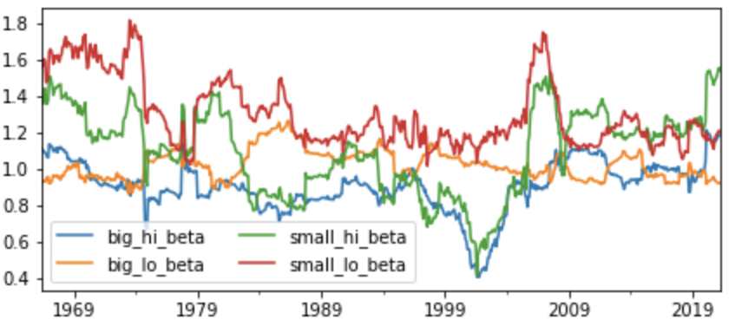
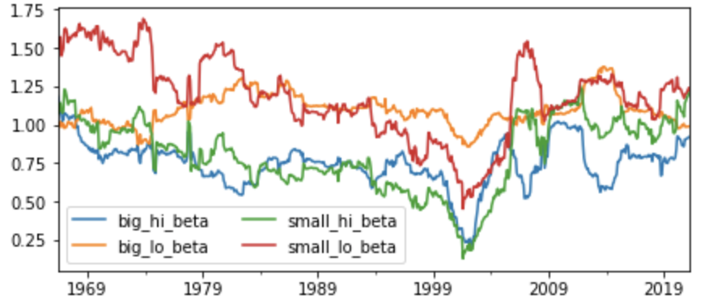
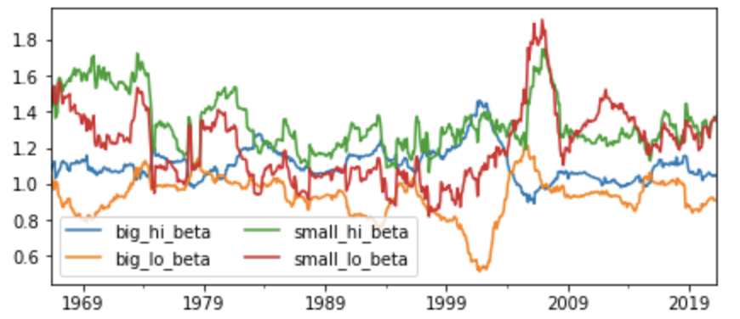
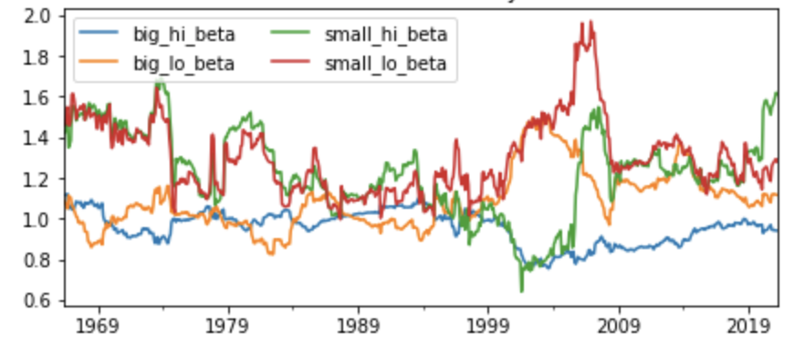
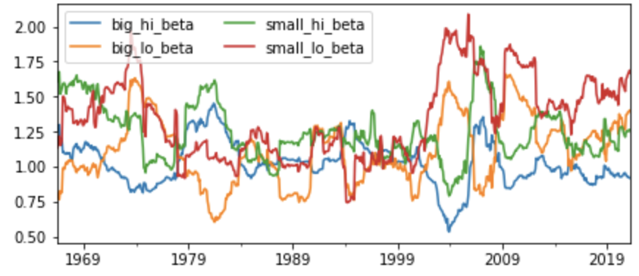
QUESTION 1
Value Weight :Taking the market return from Fama-French’s 3-factor model, calculate and plot the rolling 3-year market beta for these stylized portfolios.
Beta : Book-to-Price
Beta : Cash-to-Price
Beta : Dividend Yield
Beta : Investment
Beta : Profitability
Beta : Prior Month Return
Beta : 12-1 momentum
For value weighted, based on these seven fundamental variables, we can see the overall trend is that the small cap stocks beta are higher than the big cap, low growth beta are higher than high growth beta, these mean that big cap and high growth beta are more stable in the market.

Slide 8
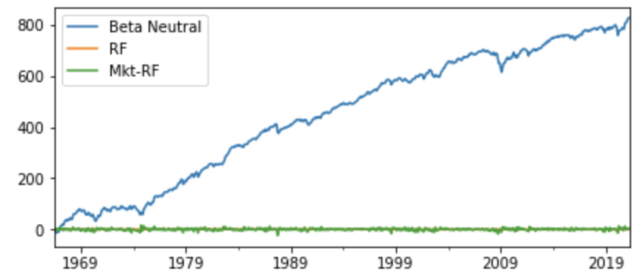
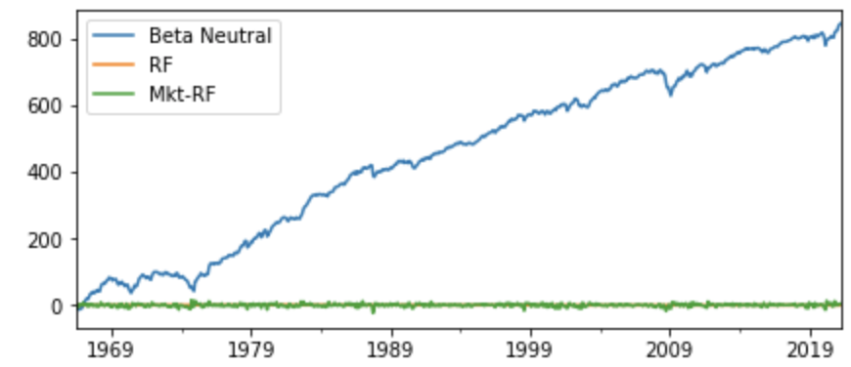
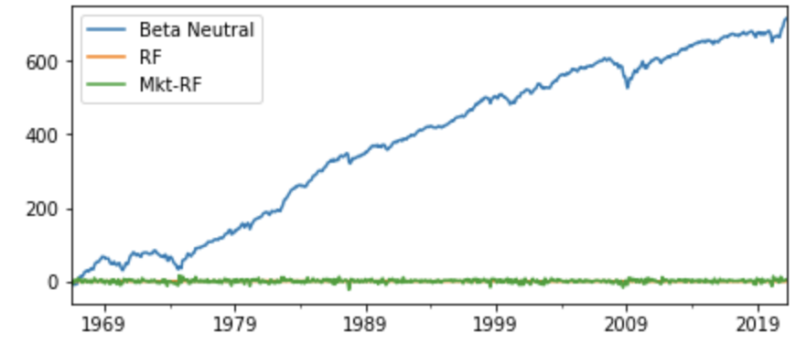
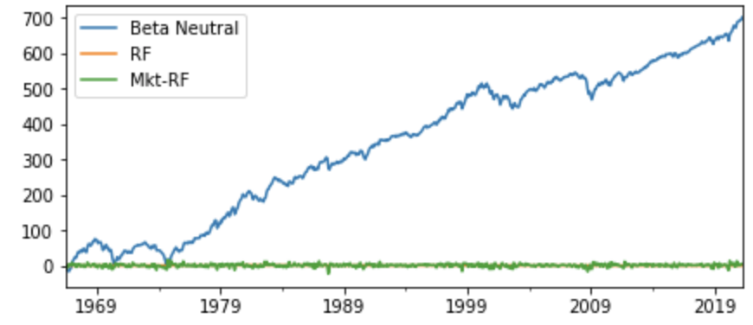
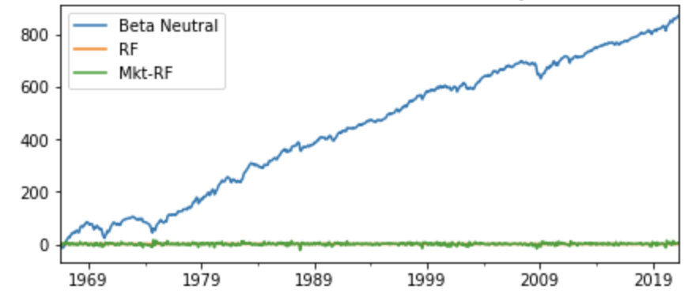
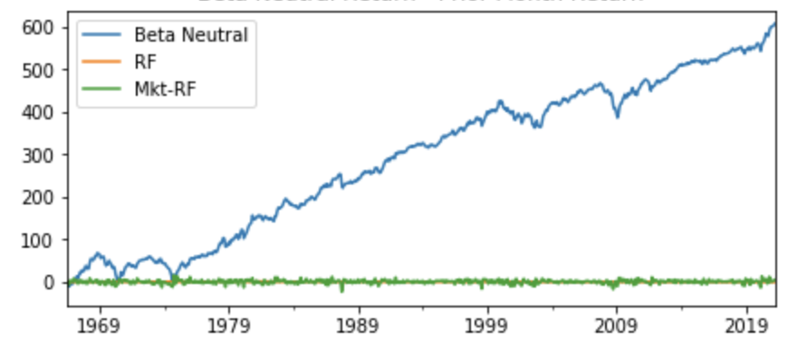
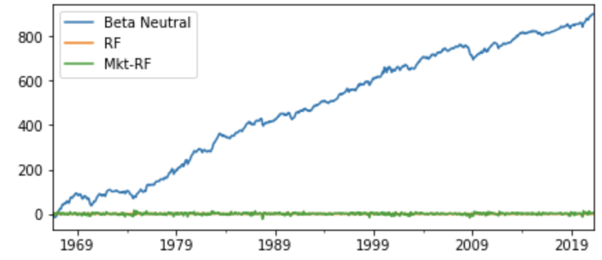
QUESTION 1
Value Weight : Considering both size segments, construct a beta-neutral factor mimicking portfolio for each fundamental variable.
Beta-neutral Return : Book-to-Price
Beta-neutral Return : Cash-to-Price
Beta-neutral Return : Dividend Yield
Beta-neutral Return : Investment
Beta-neutral Return: Profitability
Beta-neutral Return : Prior Month Return
Beta-neutral Return : 12-1 momentum
The graphs albeit the same increasing trend are based on each of the different factors, the growth is driven by the market and the magnitude varies.
For the Book-to-Price, Cash-to-Price, Dividend Yield – the profiles are relatively stable compare to the other 4.

Slide 9
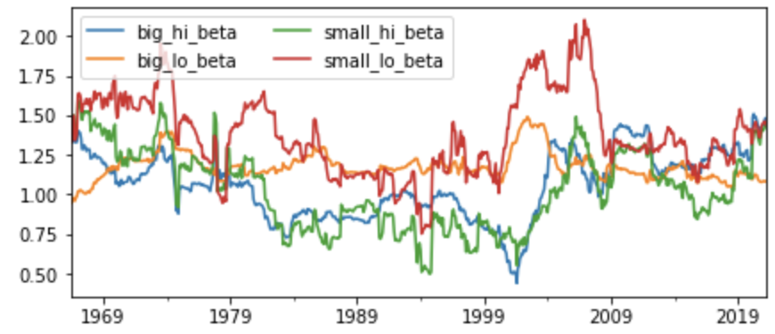
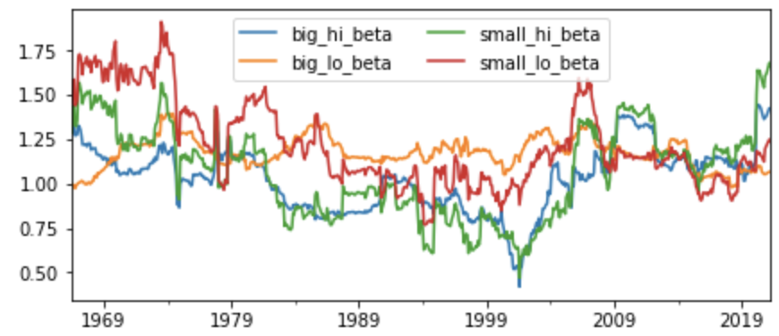
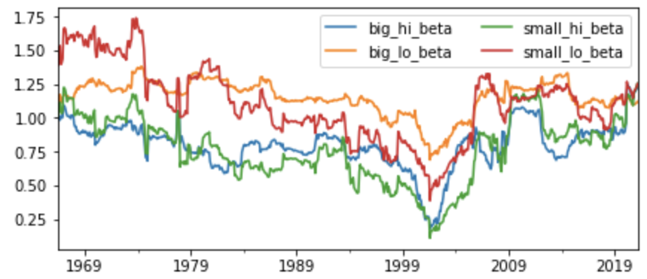
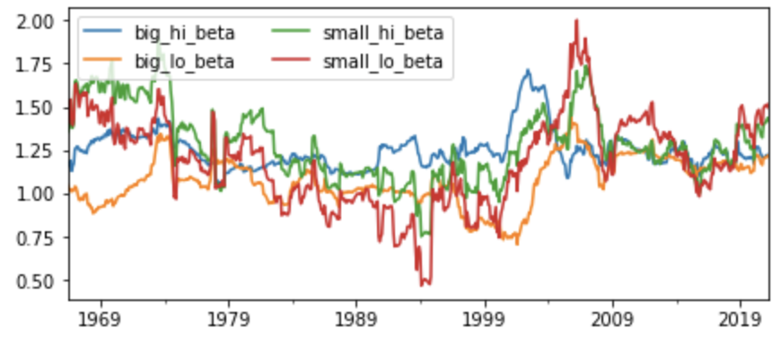
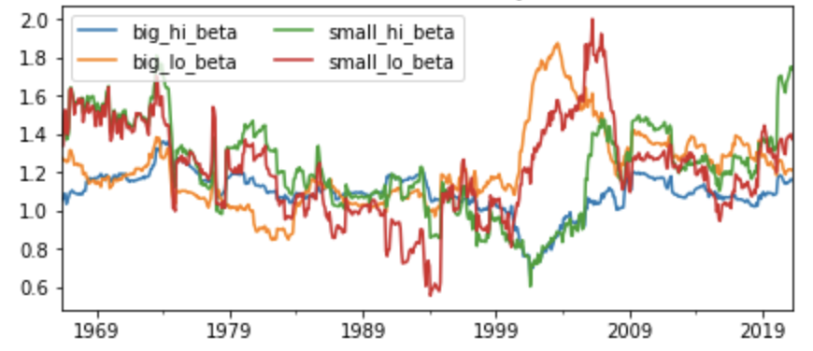
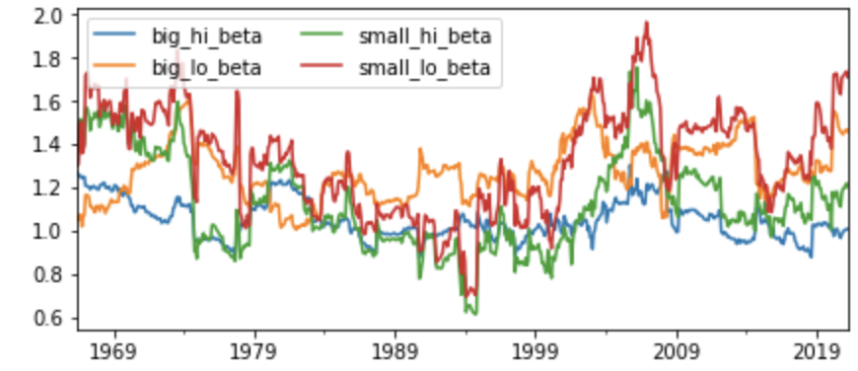
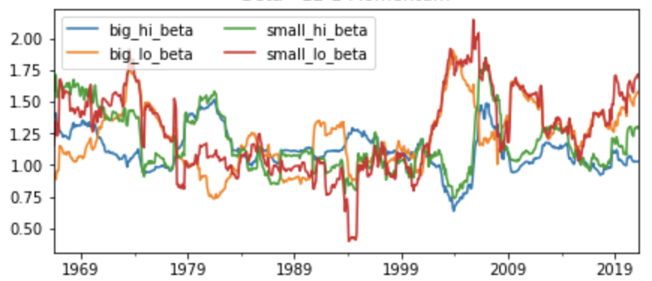
QUESTION 1
Equal Weight :Taking the market return from Fama-French’s 3-factor model, calculate and plot the rolling 3-year market beta for these stylized portfolios.
Beta : Book-to-Price
Beta : Cash-to-Price
Beta : Dividend Yield
Beta : Investment
Beta : Profitability
Beta : Prior Month Return
Beta : 12-1 momentum
For equal weighted, compared with the value weighted, the overall trend has no big difference. But as graphs shows above, we can find that some variables ,like Investment ratio, profitability, Prior Month return and 12-1 momentum, their small_lo_beta are all reached to 2.00 .

Slide 10
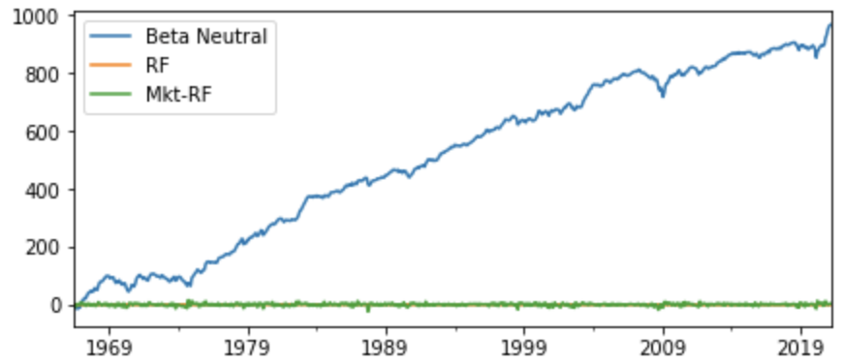
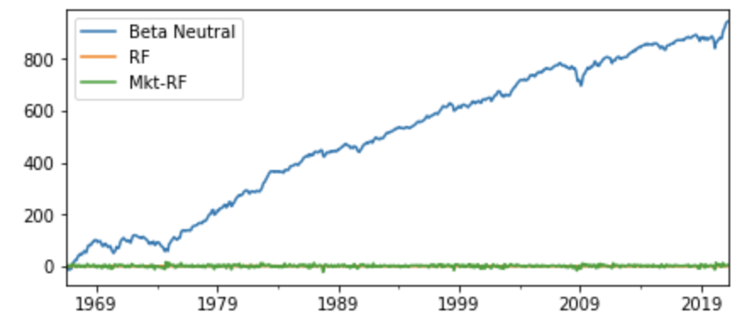
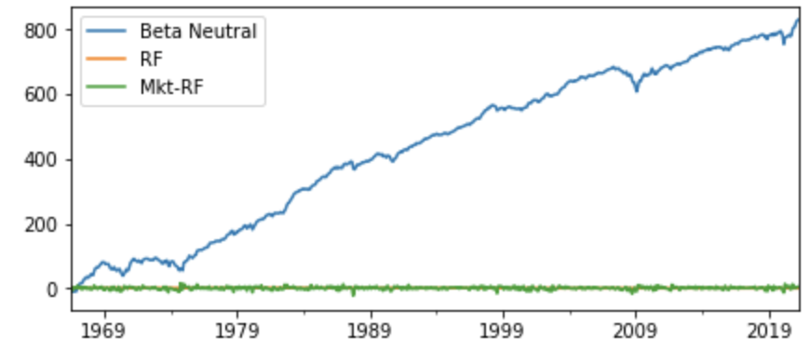
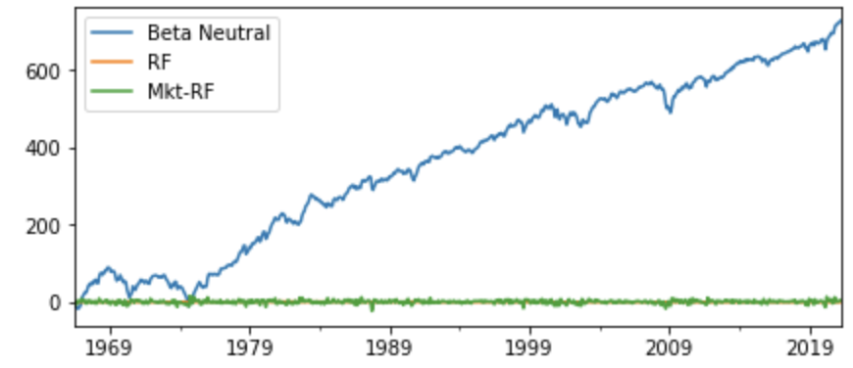
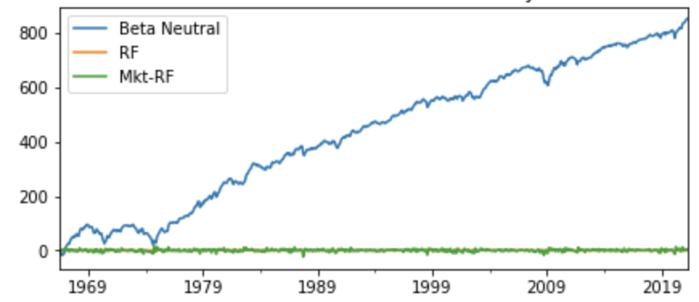
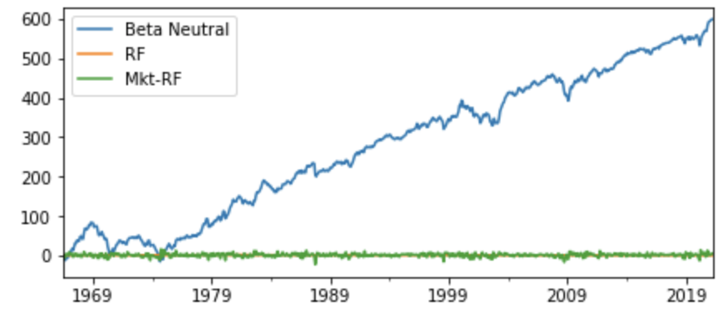
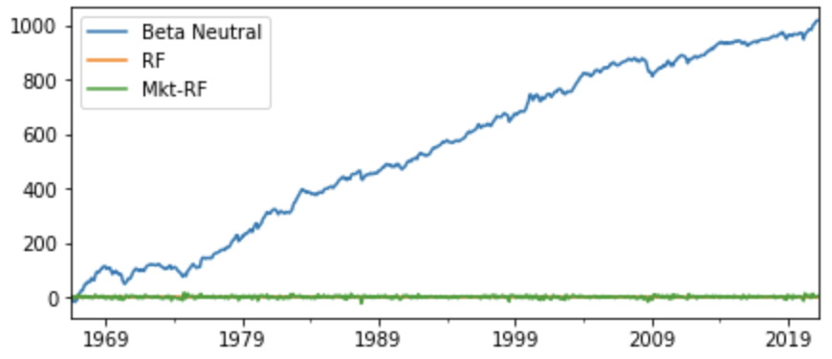
QUESTION 1
Equal Weight : Considering both size segments, construct a beta-neutral factor mimicking portfolio for each fundamental variable.
Beta-neutral Return : Book-to-Price
Beta-neutral Return : Cash-to-Price
Beta-neutral Return : Dividend Yield
Beta-neutral Return : Investment
Beta-neutral Return: Profitability
Beta-neutral Return : Prior Month Return
Beta-neutral Return : 12-1 momentum
The observations on the prior Month Returns and the Investments show higher noise as compared to the rest.

Slide 11
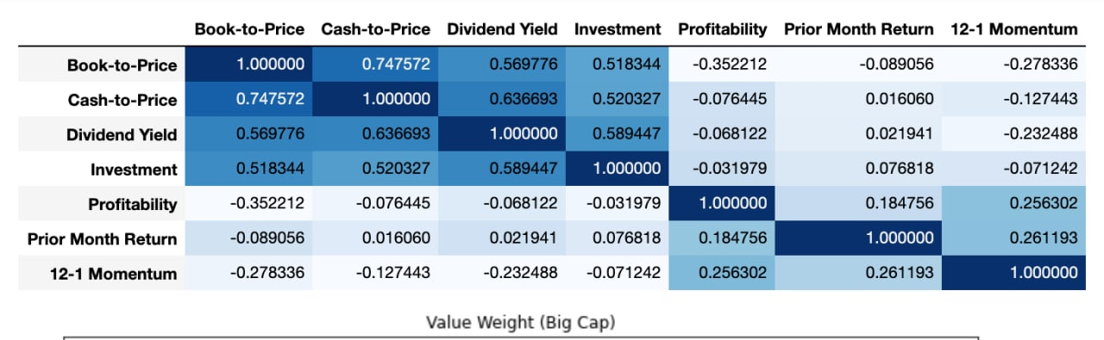
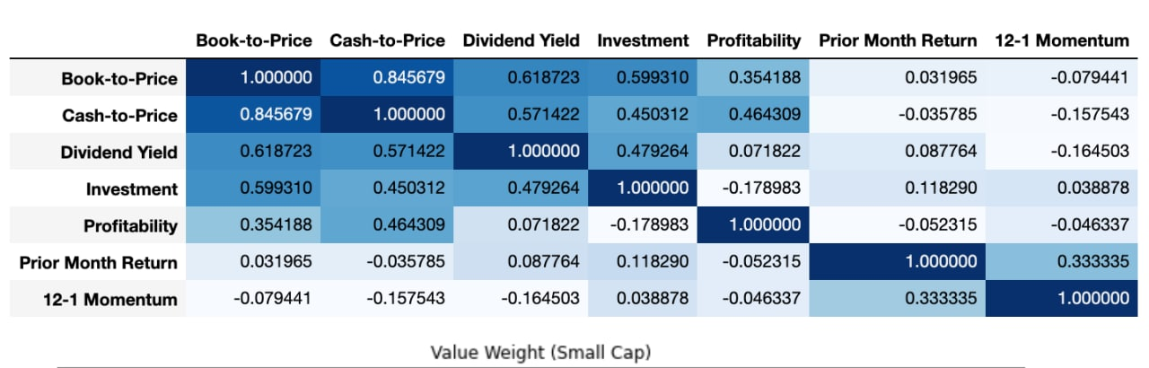
QUESTION 2
Calculate the full sample correlation matrix of unadjusted factor returns derived from Question 1
Correlation Matrix – BIG CAP VALUE WEIGHTED
The correlations between B/P, CF/P, and Dividend Yield portfolios returns are largely positive.
These same portfolios display significant negative correlation with the Investment factor mimicking portfolio.
Correlation Matrix – SMALL CAP VALUE WEIGHTED
The correlations between B/P , CF/P and operating profitability are significantly positive for small-cap

Slide 12
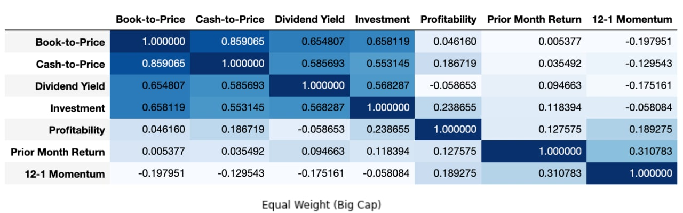
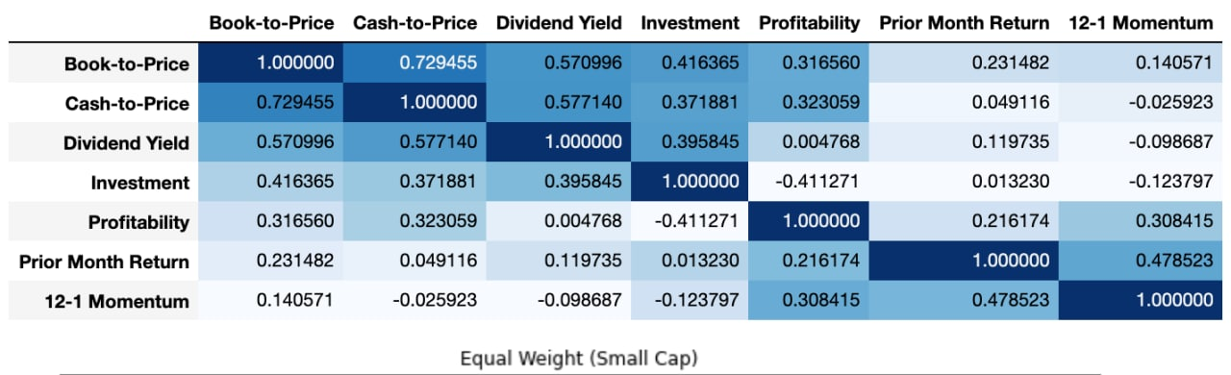
QUESTION 2
Calculate the full sample correlation matrix of unadjusted factor returns derived from Question 1
Correlation Matrix – BIG CAP EQUAL WEIGHTED
The correlation matrixes of equal-weighted portfolios show similar patterns with the value-weighted portfolios.
Correlation Matrix – SMALL CAP EQUAL WEIGHTED

Slide 13
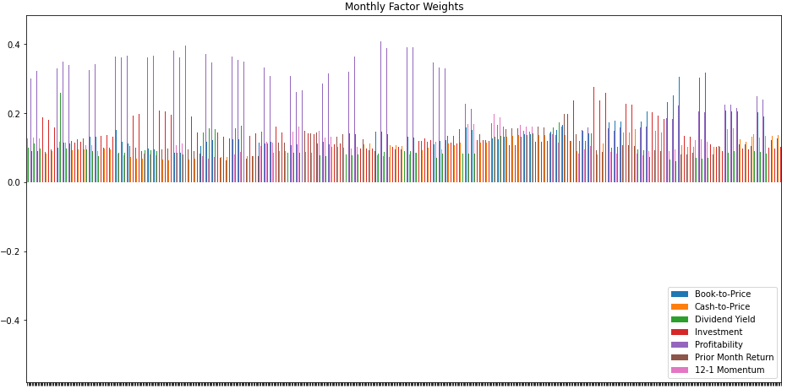
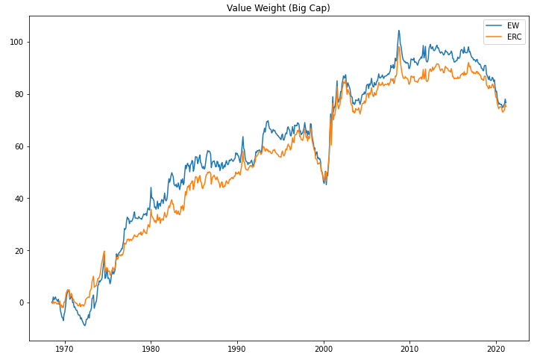
QUESTION 2
Using a lookback period of 5 years, employ an equal risk contribution factor weighting strategy with monthly rebalancing. Plot the monthly factor weights over time and evaluate the strategy performance against the static value weighted factor portfolio.
BIG - CAP Portfolio Monthly Factor Weights
ERC Spreads VS. VW Spreads
ERC Performance
VW Performance
To achieve the equal risk contribution (ERC) portfolio and required to short certain portfolios, we extend the limit of the portfolio weights and of the factor mimicking portfolios to numbers between -1 and 1.
Annualized Sharp Ratio
0.26784
0.24204
Annualized Returns
142.65
145.28

Slide 14


QUESTION 2
Using a lookback period of 5 years, employ an equal risk contribution factor weighting strategy with monthly rebalancing. Plot the monthly factor weights over time and evaluate the strategy performance against the static value weighted factor portfolio.
SMALL - CAP Portfolio Monthly Factor Weights
ERC Spreads VS. VW Spreads
ERC Performance
VW Performance
Annualized Sharp Ratio
0.54221
0.48958
Annualized Returns
274.885
282.375

Slide 15


QUESTION 2
Using a lookback period of 5 years, employ an equal risk contribution factor weighting strategy with monthly rebalancing. Plot the monthly factor weights over time and evaluate the strategy performance against the static equally weighted factor portfolio.
BIG - CAP Portfolio Monthly Factor Weights
ERC Spreads VS. EW Spreads
ERC Performance
EW Performance
Annualized Sharp Ratio
0.29099
0.28301
Annualized Returns
158.023
174.612

Slide 16


QUESTION 2
Using a lookback period of 5 years, employ an equal risk contribution factor weighting strategy with monthly rebalancing. Plot the monthly factor weights over time and evaluate the strategy performance against the static equally weighted factor portfolio.
SMALL - CAP Portfolio Monthly Factor Weights
ERC Spreads VS. EW Spreads
ERC Performance
EW Performance
Low-valued small cap stocks likely to be hit harder during stressed periods.
Majority of returns profile remains positive for higher-valued stocks.
Annualized Sharp Ratio
0.59960
0.42986
Annualized Returns
297.617
258.124
Overall results have shown that the Equal Weighted Portfolios outperforms the ERC Portfolio

Slide 17


QUESTION 3
Using different lookback periods of 12 and 36 months to determine factor persistence
Calculate the cumulative excess return and test the factor persistence in the value/equal weighted universe.
Construct factor by longing the lower percentile factor return and shorting the higher percentile factor return in the same market capitalization. The factor return calculation formula is as follows:
$\frac{1}{2}[\left(small low factor return+large low factor return\right)−$ $(small high factor return+large high factor return)]$

Slide 18


QUESTION 3
Using different lookback periods of 12 and 36 months to determine factor persistence
Our Understanding for persistence： Positive autocorrelation is an indication of a specific form of persistence
Take a regression of factor returns against lagged factor returns, significantly low P-values indicating low autocorrelation.

Slide 19


QUESTION 3
Building adaptive multi-factor models that appropriately reflect your view on each factor.
Our factor weighting scheme is to maximize Sharpe ratio of the multifactor portfolio by solving the following optimization problem:
$$\max_{w}{\frac{w^{T}μ}{sqrt(w^{T}Σw)}}$$
Subject to $Σ_{i}w_{i}=1, −1 ≤ w_{i} ≤$ 1, where $μ$ is an excess return over a risk-free rate and 𝛴 is covariance matrix of excess return.
We tested the performance of value weighted and equal weighted multifactor portfolio using different lookback periods of 12 and 36 months', respectively. We used the 12-month rolling window to calculate factor weights for the next one month.

Slide 20

QUESTION 3
Building adaptive multi-factor models that appropriately reflect your view on each factor.
Sharpe ratio weighted portfolio cumulative return
from 1967 to 2020
All cumulative return lines are increasing.
Same lookback period, equal weighted portfolio’s cumulative product return is higher than the value weighted portfolio.
The value weighted portfolio returns with different lookback period are almost the same.
And the equal weighted portfolio with 12-month lookback period is the higher than the one with 36-month lookback period.

Slide 21

QUESTION 3
Building adaptive multi-factor models that appropriately reflect your view on each factor.
Sharpe ratio weighted portfolio cumulative product return
from 2010 to 2020
We can see all cumulative product return lines are somewhat flat as we use shorter time period.
The equal weighted portfolio performs worse than the value weighted portfolio for the same lookback period.
The equal weighted portfolio with 12-month lookback period performs worst and value weighted portfolio with 12-month lookback period performs better than the others
 | EW_12 | EW_36 | VW_12 | VW_36
Annual Excess Return (%) | 1.8289 | 0.6273 | 3.0468 | 2.1375
Annual Sharpe Ratio | 0.1862 | 0.0524 | 0.2793 | 0.1879

Slide 22


QUESTION 3
Building adaptive multi-factor models that appropriately reflect your view on each factor.
Minimum Variance Portfolio – Value Weighted
We calculate the weights from Jan 2016 to Jan 2018 according to Minimize Variance model and test the model's performance from Feb 2018 to June 2019.
We find this model can diversify the risk better than Maximum Sharpe Ratio model as the returns are around 1 all the time.
But this model's return is much lower than the return of Maximum Sharpe Ratio model.
Minimum Variance Portfolio – Equal Weighted

Slide 23
Q & A

Slide 24
Thanks

